Slide 1
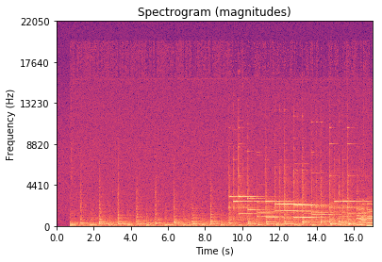


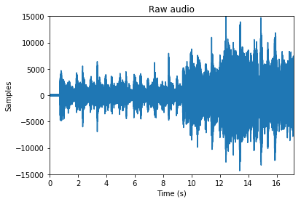
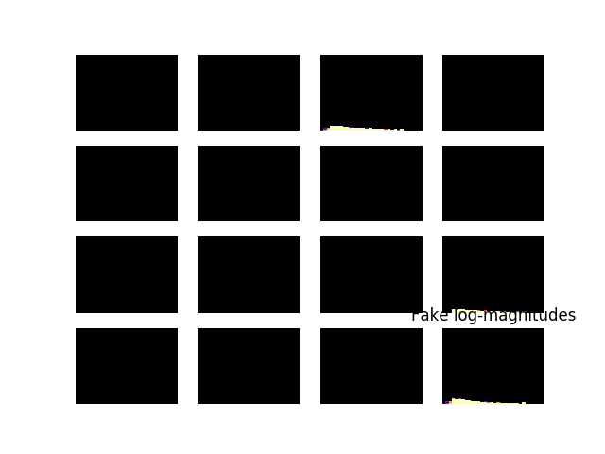
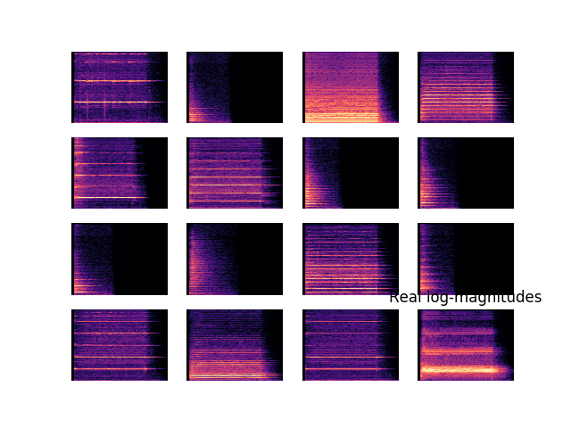
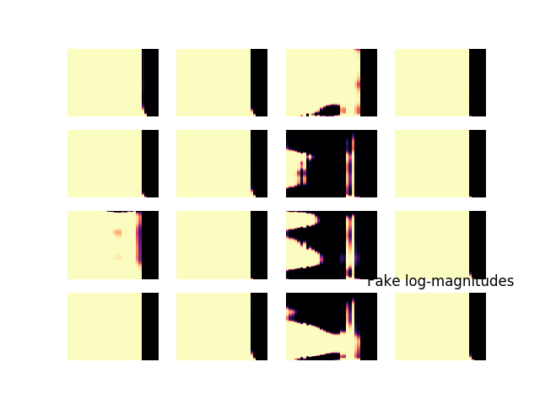
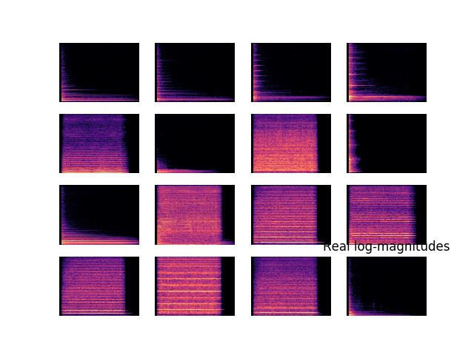
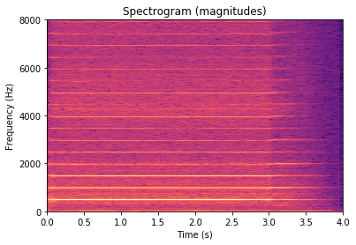
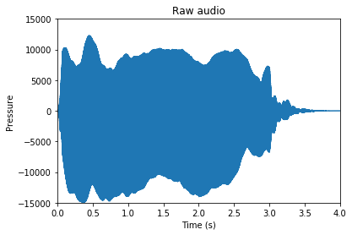
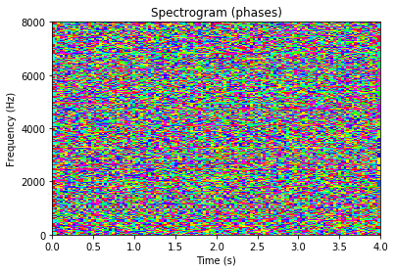
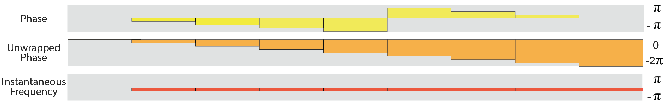
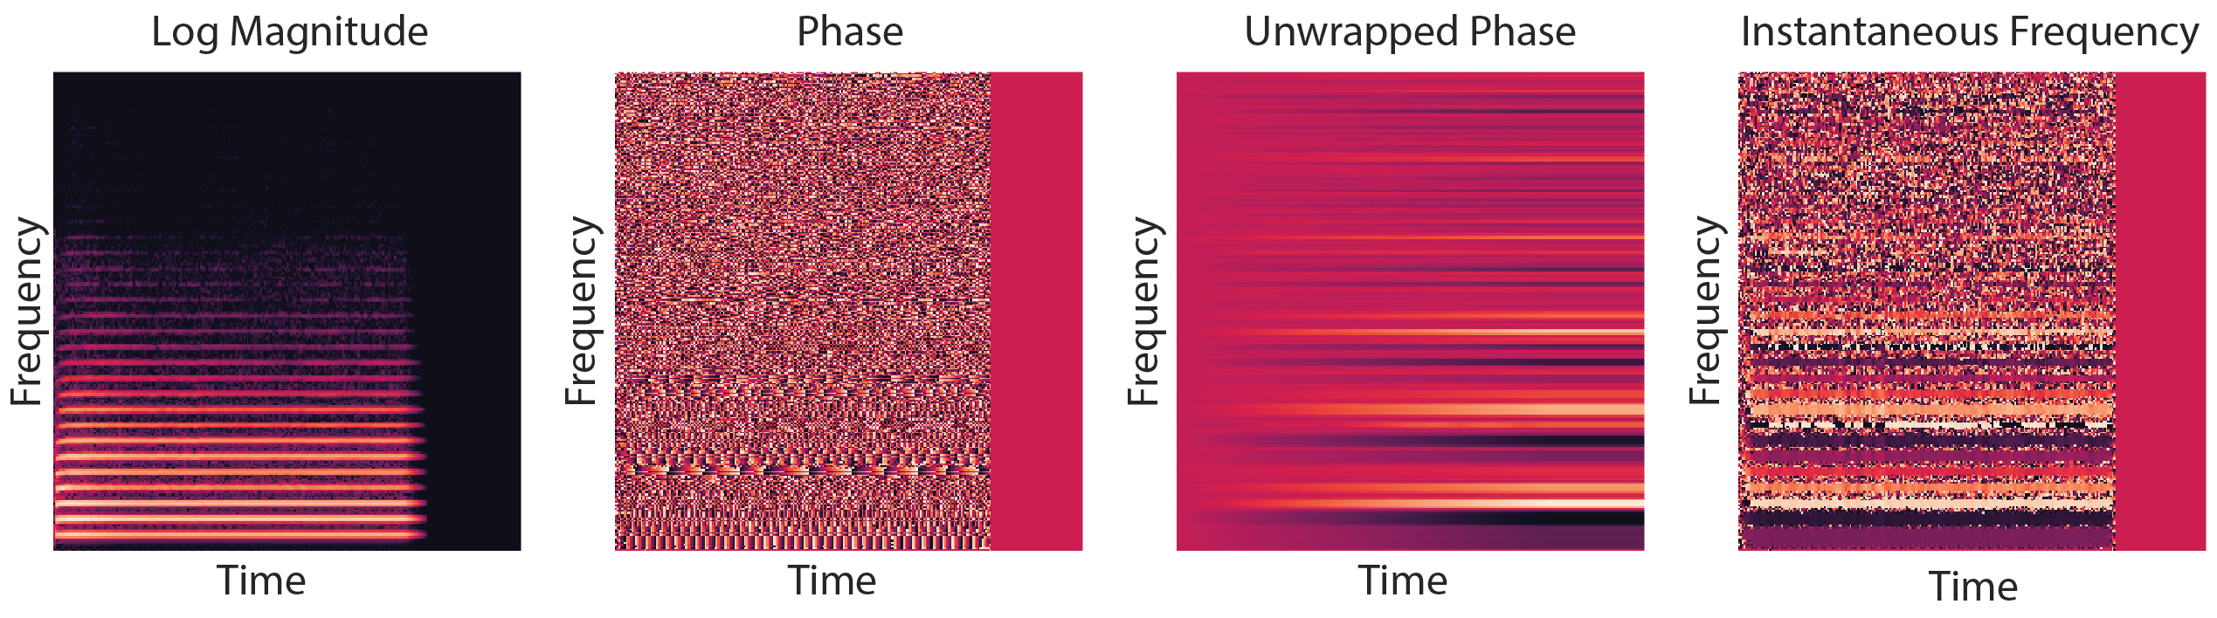




Purpose
Data/Results
Synthesizing realistic audio using generative adversarial networks
Machine learning has successfully been applied in many fields, such as image classification, speech recognition, etc., but it has been lagging in application in the arts. This research aims to use novel machine learning techniques to synthesize music in the form of raw audio.
Preliminary testing was done by replicating the work of Engel et al. (2019) using a tensor processing unit (TPU), a machine learning accelerator proprietary to Google. The generous support of the TensorFlow Research Cloud (TFRC) provided me with cloud computing resources and TPU access for free, providing the computing resources needed for free.
Since the API for a TPU is much less flexible than the API for GPUs, progress thus far has been in trying to replicate the work of Engel et al. (2019) on a TPU, i.e. a GAN was trained to generate only single notes.
The NSynth dataset of single 4 second notes was used as in Engel et al. (2019). The dataset was first introduced by Engel et al. (2017).
Phase 1: Training a generative adversarial network (GAN)
Generative adversarial networks
Generative adversarial networks (GANs) consist of a generator and discriminator.
The generator takes a series of random numbers and outputs a picture, while the discriminator takes in a picture and outputs a number representing a guess of if the input picture is training data or came from the generator.
In trying to outcompete each other, the generator and discriminator are both trained. The output of the generator is usually used.
Methodology
A spectrogram made as in Engel et al. will be made from a audio of whole songs. A GAN will then be trained to generate narrow columns (narrow in time) of the spectrogram.
From auburnacschool.org
Background
$𝒢$
$𝒟$
Audio
Sounds are pressure waves that propagate through air.
Audio is stored as records of pressure over time, sampled many times (ex. 44100 times) per second.
Spectrograms
The fast Fourier transform (FFT) calculates magnitudes and phases of a series of sinusoidal waves of different frequencies that can be used to exactly reconstruct the input of the FFT.
A short-term Fourier transform (STFT) uses to FFT across different intervals of a given audio signal to generate a spectrogram.
Generated spectrograms (magnitudes)
Real spectrograms (magnitudes)
Audio waveform graphed and generated spectrogram is Dance of the Sugar Plum Fairy from free-stock-music.com
Phase 2: Encoding data
Latent space
The generator has to try to find meaning in the random numbers it uses as inputs, so these random numbers become dense with information after the GAN is trained.
The latent space can be reconstructed by using backpropagation and gradient descent, “training” the inputs of the generator to match a certain output (Lipton & Tripathi 2017).
Methodology
Spectrograms from phase 1 will converted into a series of latent spaces to densely encode the information about the audio of the songs.
$𝒢$
Training time: around 6 days
TPU utilization: <5%
Generated from the NSynth dataset, Engel et al. (2017), https://magenta.tensorflow.org/datasets/nsynth
Audio waveform graphed and generated spectrogram is Dance of the Sugar Plum Fairy from free-stock-music.com
The difference in training time between the two sets of generated spectrograms shown is very small (<0.1%).
Current research
Engel et al. (2019) has successfully generated modified spectrograms using “instantaneous frequency” as a way to get patterns from the phase in a spectrogram. This, along with the use of recent generative adversarial network (GAN) training techniques, have allowed them to generate single notes state-of-the-art in quality.
Conclusion
Phase 3: Training a recurrent neural network (RNN)
Even though the procedure of Engel et al. was followed very carefully, the generated spectrograms were still very unrealistic, looking not at all like the real spectrograms. This is likely due to the nature of the API required for the TPU being unsuitable for GANs; a TPU is more suited for a linear network, while a GAN requires alternating between training the discriminator and generator. The unsuitability of a TPU for this task is further suggested by the low TPU utilization and the rapid oscillation of generated spectrograms with training. This could be mitigated in the future by a more optimized implementation of a GAN or an investigation into alternative sources of computing power which would require additional funding.
The lack of success with even training single notes and essentially replicating previous work is discouraging. However, if this hurdle of training a GAN on a TPU can be overcome, phase 1 of the planned idea should be relatively easy to accomplish by only replacing the dataset used and changing the input pipeline slightly.
Recurrent neural networks
Recurrent neural networks (RNNs) find patterns in data with a time component.
RNNs have been used in applications such as speech-to-text, language translation, and even generation of simple piano melodies (in MIDI and not in raw audio like this research).
Methodology
The usefulness of RNNs to capture information in time data will be combined with the dense representation of music from phase 2 to generate new series of latent spaces.
These new series of latent spaces can be transformed into spectrograms with the generator from phase 1 and into raw audio, hopefully with the raw audio being a new piece of music.
RNN
$𝒢$
Engel et al. (2019)
Hypothesis
The combination of GANs and RNNs planned to be used should be able to capture the complexities in music, being able to generate whole pieces much larger in scale and with much more detail than current techniques.
Audio waveform graphed and generated spectrogram is Dance of the Sugar Plum Fairy from free-stock-music.com

